Slide 1
Thematic Presentation
Personal history
lumi

Slide 2
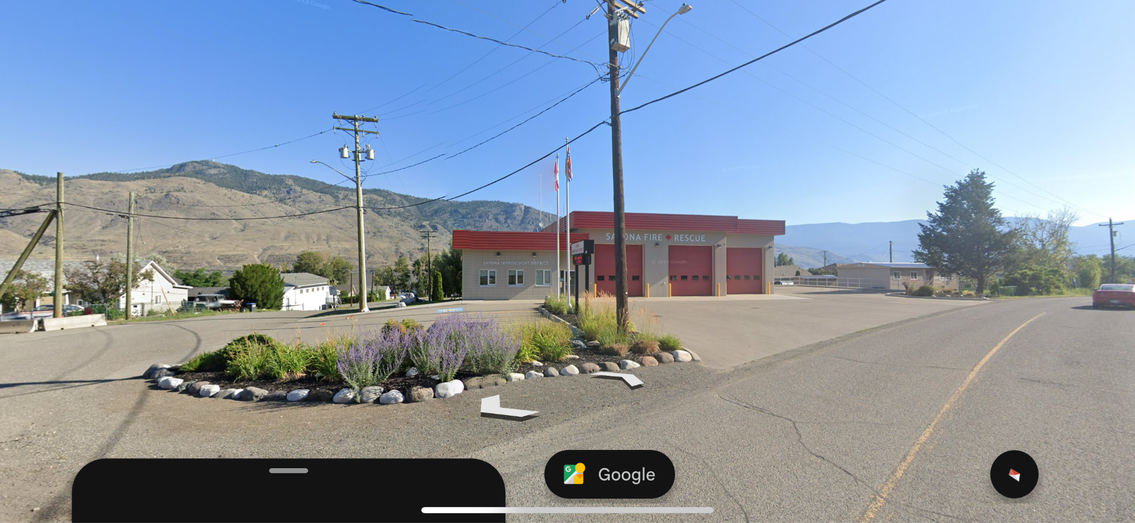
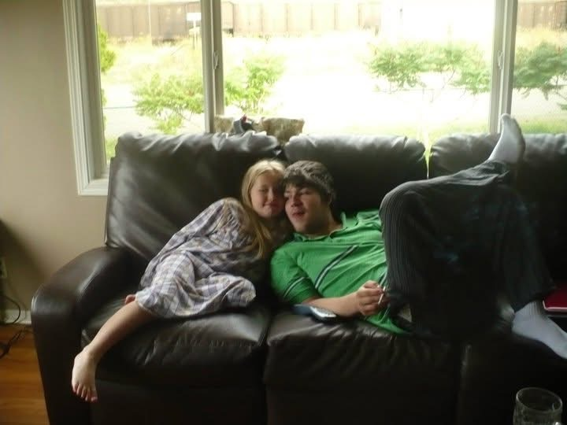
Personal History as a theme
My life has been incredibly long, and I’ve gone through more hardships and unique but troubling experiences than I can name. As soon as I reached an age where foggy memories appear I had to live in a dangerously violent home, navigate foster care and a constantly changing environment, dealt with many types of abuse and neglect- As a child danger was loud and unpredictable, while as a teen it was quiet and suffocating in my new home. Without going into any further detail- I can say I have a near endless amount of emotional experiences to work through via expression.This means I have a wide array of ways to convey these ideas through imagery. So far I’ve found myself collecting images of the places I lived in and visited as a child to use as settings for my drawings.
Fire station beside my childhood home
From google earth
Childhood living room

Slide 3
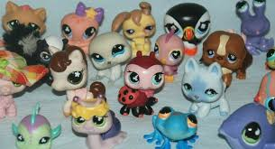
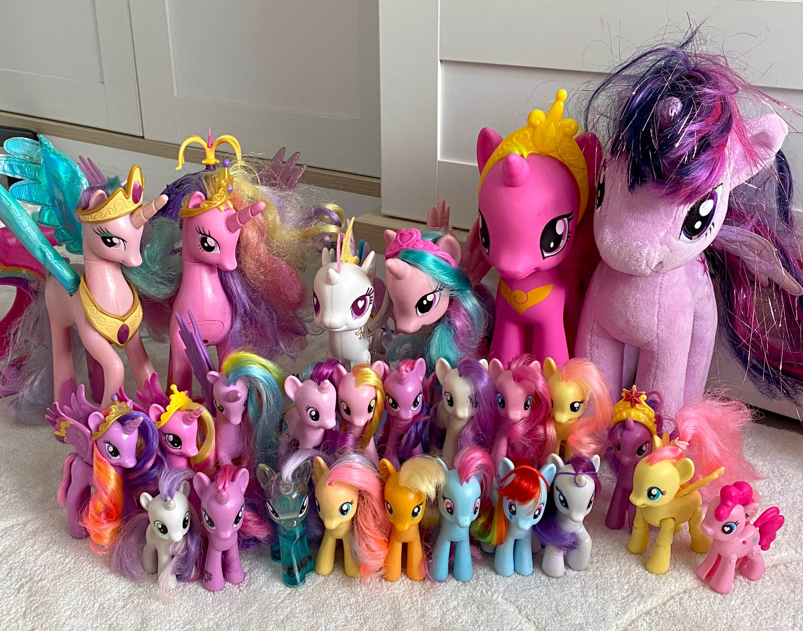
Cont.
Another piece of imagery I’d like to play with alongside settings inspired by real places, my usual figures and abstraction is childhood toys. I recall re-enacting many of the inappropriate and violent things I was exposed to with my incredibly cute little toys. This contrast is something I’d like to work with as I explore the visual imagery I will use to represent my experiences, and my emotions surrounding them. To this end I’d like to incorporate the artistic style and playfulness of the artist I’ve chosen to research in the lightest parts of my drawing, to help bring a sense of childlike quality to the pieces harkening back to my childhood.

Slide 4
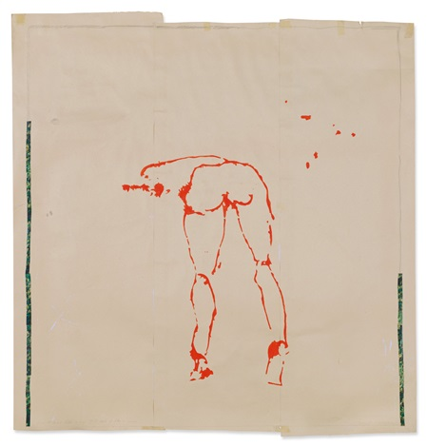
Artist // Tracey Emin
The artist I chose whose techniques and subject matter interest me, and align partially with the themes I want to explore is Tracey Emin. She was born in 1963 and still makes work and shows in galleries today. Her work, like mine, is deeply personal and often is described in articles as painful, raw and unadulterated. She works in many materials, from drawing to lithography, sculpture and painting. Online she still posts on instagram, and her captions are often deep insights into her thoughts and feelings that relate to her artwork and her life in general.
Give it to me like a man and I’ll take it like a man,
date: 2000
media: acrylic, pencil and collage on three adjoined paper sheets
Size: 62.7 x 58.7 in

Slide 5
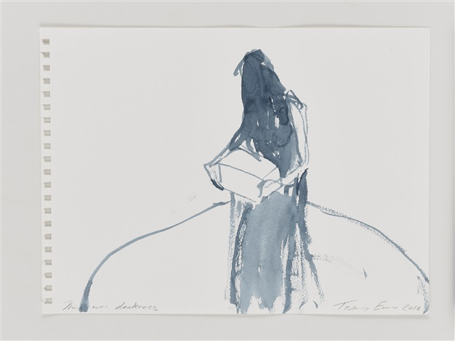
Tracy Emin, cont
Her work varies in complexity but often leans into a sketch type of feel. With paints, lithograph and classic drawing tools she creates many loose figure drawings which convey different personal experiences and feelings. Her work’s simplicity is something I highly appreciate. The vulgarity and play leaving room for interpretation and imagination for the viewer. Her both careful and playful use of composition and jagged line cut through occasionally by a skilled smoothness of a well practised artist is inspiring.
There was darkness
2018
Acrylic on paper
11x15 in

Slide 6
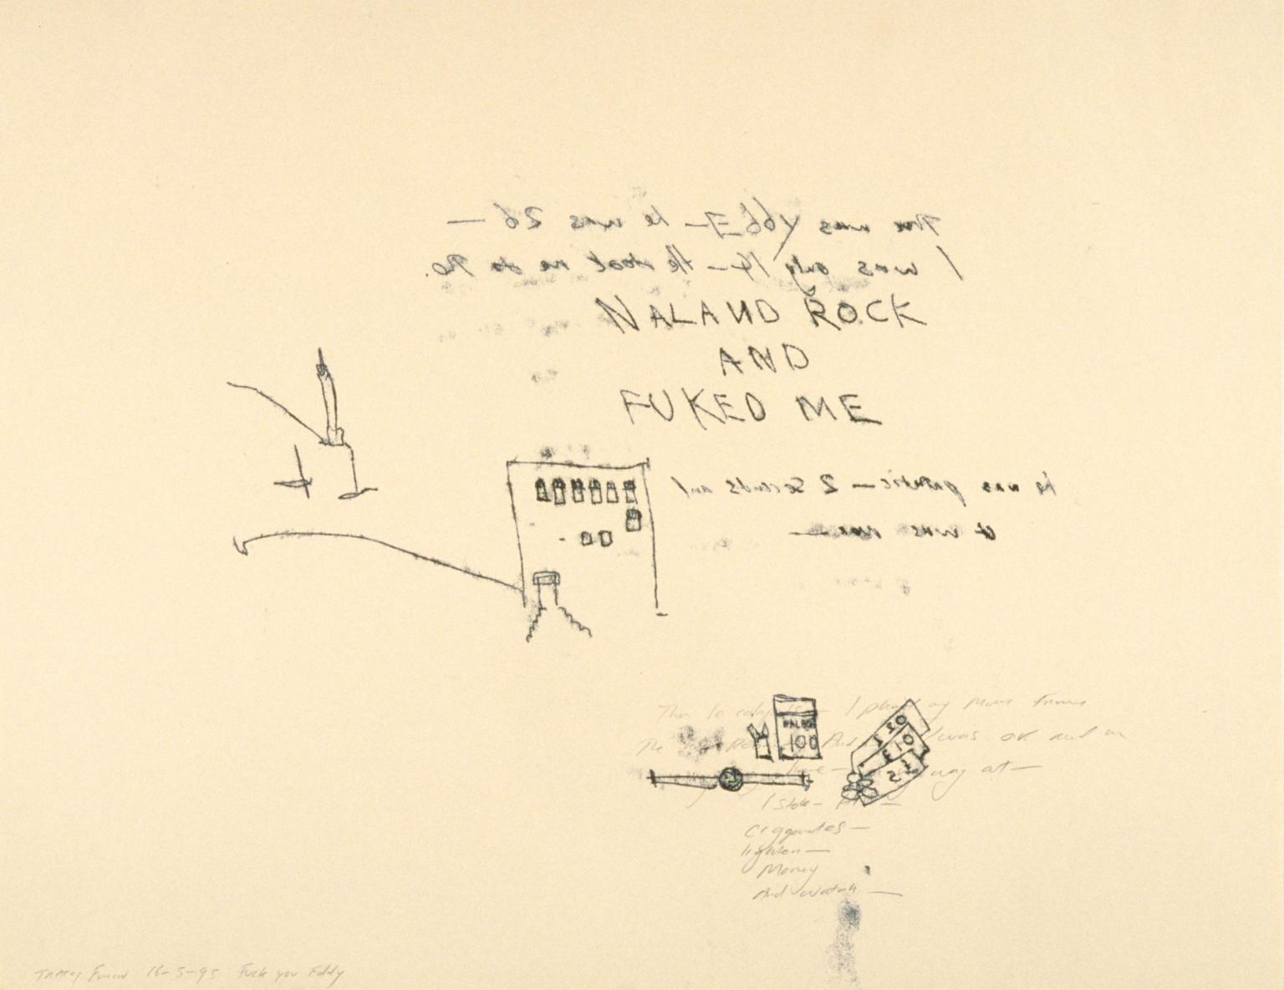
Concluding words
The last thing I’d like to talk about in this presentation in regard to my theme is why it matters. Why am I sharing all these uncomfortable and personal details about myself? Why would I want to share art about that? Of course for the purposes of processing and relief, but also for visibility. Millions of people experience one or more of the many things I’ve been through, and it’s hard to live in a society where a messy life story is seen as uncomfortable. As something private to be ashamed of and quiet about- I want to encourage others to be open as they want to be. To remove the stigma around a hard life, to make the awful parts palatable and visual. While I always had a chipper attitude, and kept my bubbly personality it feels good to include the ugly parts as part of the whole of who I am, and I want to encourage others to do the same.
Fuck You Eddy
Tracey Emin
Monoprint on paper
22.9 x 29.6 in

